Slide 1
Consumer Complaints Group H
Gandhi, Siddharth
Huang, Jialiang
Patel, Harshit
Patel, Jigarkumar

Slide 2
Overview
In this paper, comprehensive data analysis is performed using Hive, zepplin and power BI on the consumer complaints. All the above methods used for analysis comprise of Big Data platform. Hence this paper uses Big Data platform to keep and analyze Consumer Complaint data set. Then, the analysis result is visualized. The dataset comprises of the financial consumer complaints related to loan, credit card, mortgage etc.The data set is of the size 142MB and is available on http://www.data.gov/consumer/. We have chosen this dataset because it reflect the problems which we face in our everyday life. By using this data we can analyse the results and see where people face problems and where the banks and other financial institution should improve to be more consumer friendly.

Slide 3
Project Purpose
consumers can be heard by financial companies, get help with their own issues, and help others avoid similar ones. Every complaint provides insight into problems that people are experiencing, helping us identify inappropriate practices and allowing us to stop them before they become major issues. The result: better outcomes for consumers, and a better financial marketplace for everyone.

Slide 4
Apache Hadoop
Apache Hadoop is an open-source software framework written in Java for distributed storage and distributed processing of very large data sets on computer clusters built from commodity hardware.
The core of Apache Hadoop consists of a storage part, known as Hadoop Distributed File System (HDFS), and a processing part called MapReduce. Hadoop splits files into large blocks and distributes them across nodes in a cluster. To process data, Hadoop transfers packaged code for nodes to process in parallel based on the data that needs to be processed.

Slide 5
Apache Hive
Apache Hive is a data warehouse infrastructure built on top of Hadoop for providing data summarization, query, and analysis.
Apache Hive supports analysis of large datasets stored in Hadoop's HDFS and compatible file systems such as Amazon S3 filesystem. It provides an SQL-like language called HiveQL with schema on read and transparently converts queries to map/reduce, Apache Tez and Spark jobs. All three execution engines can run in Hadoop YARN. To accelerate queries, it provides indexes, including bitmap indexes.

Slide 6
Apache Zeppelin
Apache Zeppelin is a new and incubating multi-purposed web-based notebook which brings data ingestion, data exploration, visualization, sharing and collaboration features to Hadoop and Spark.

Slide 7
Power BI
Power BI is a suite of business analytics tools to analyze data and share insights.
Power BI can unify all of your organization’s data, whether in the cloud or on-premises.
Using the Power BI gateways, you can connect SQL Server databases, Analysis Services models, and many other data sources to your same dashboards in Power BI.

Slide 8
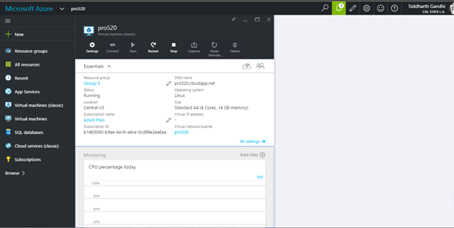
Project Implementation

Slide 9
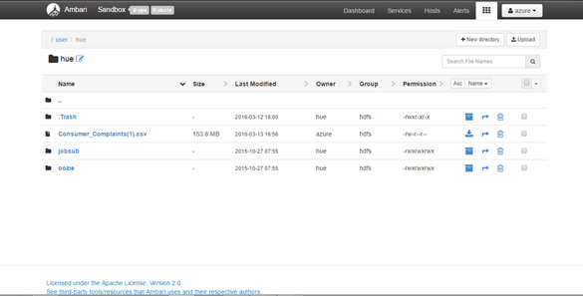

Slide 10
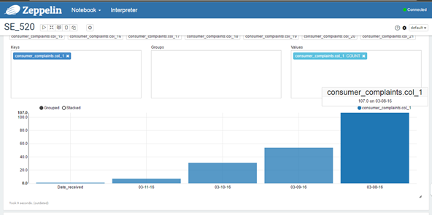

Slide 11
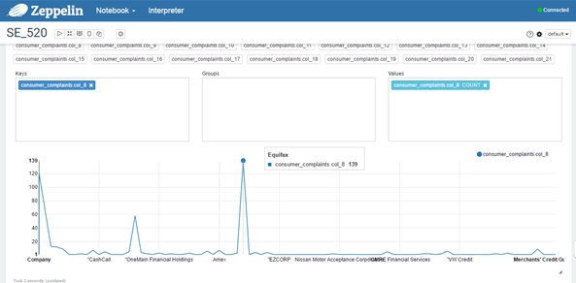

Slide 12
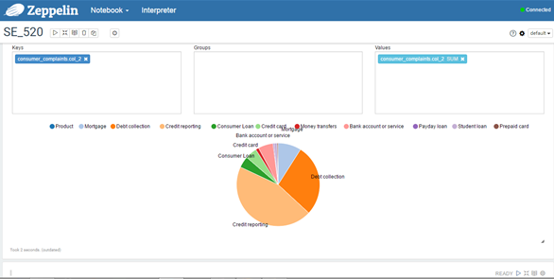

Slide 13
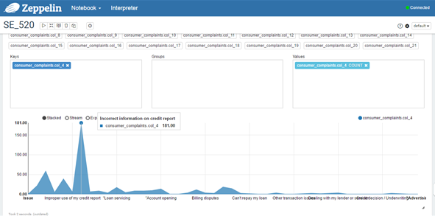

Slide 14
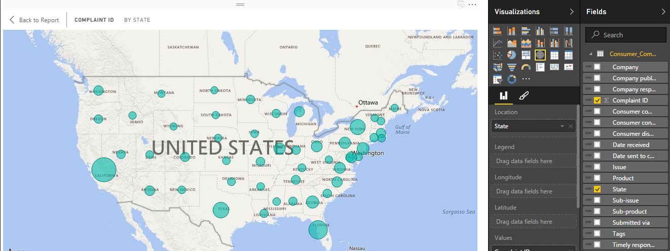

Slide 15
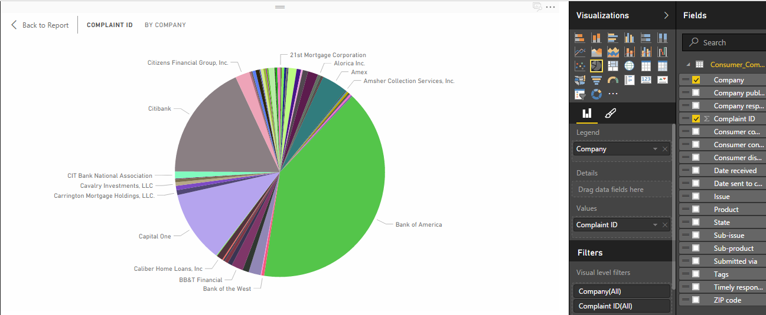

Slide 16
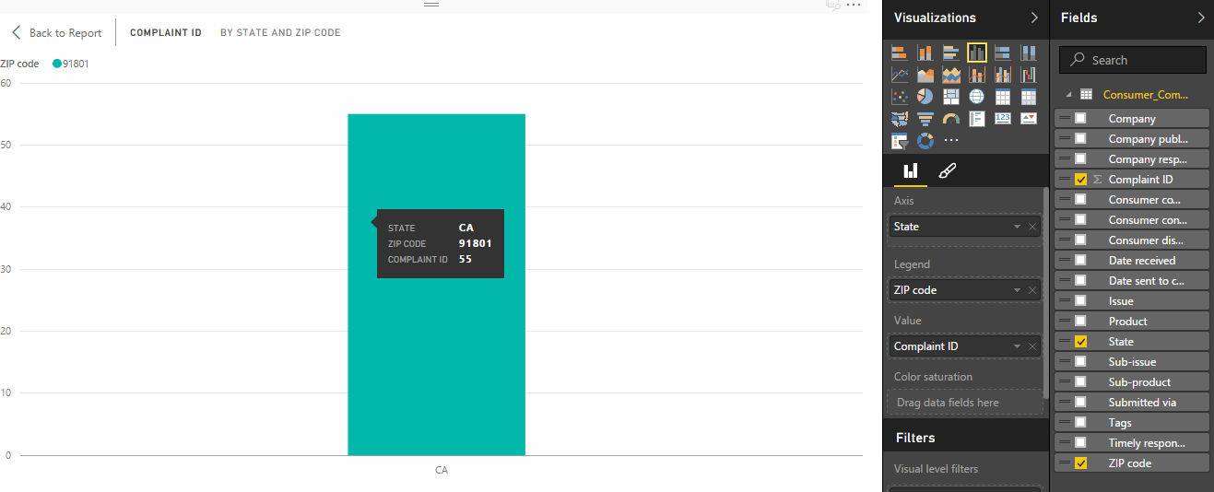

Slide 17
SLIDESHARE LINK
http://www.slideshare.net/siddharthgandhi5

Slide 18
THANK YOU

